Slide 1
Algorithms extracting 3d hand skeleton
2023/09/20

Slide 2
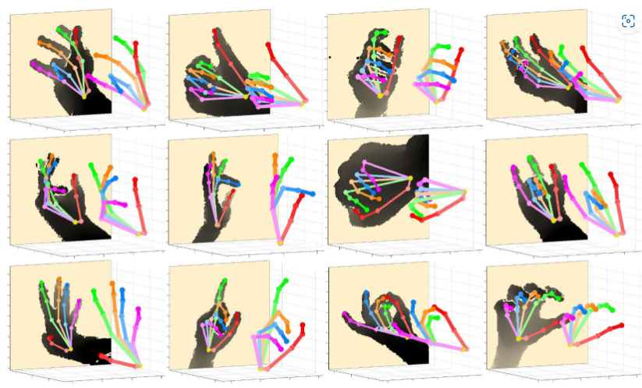
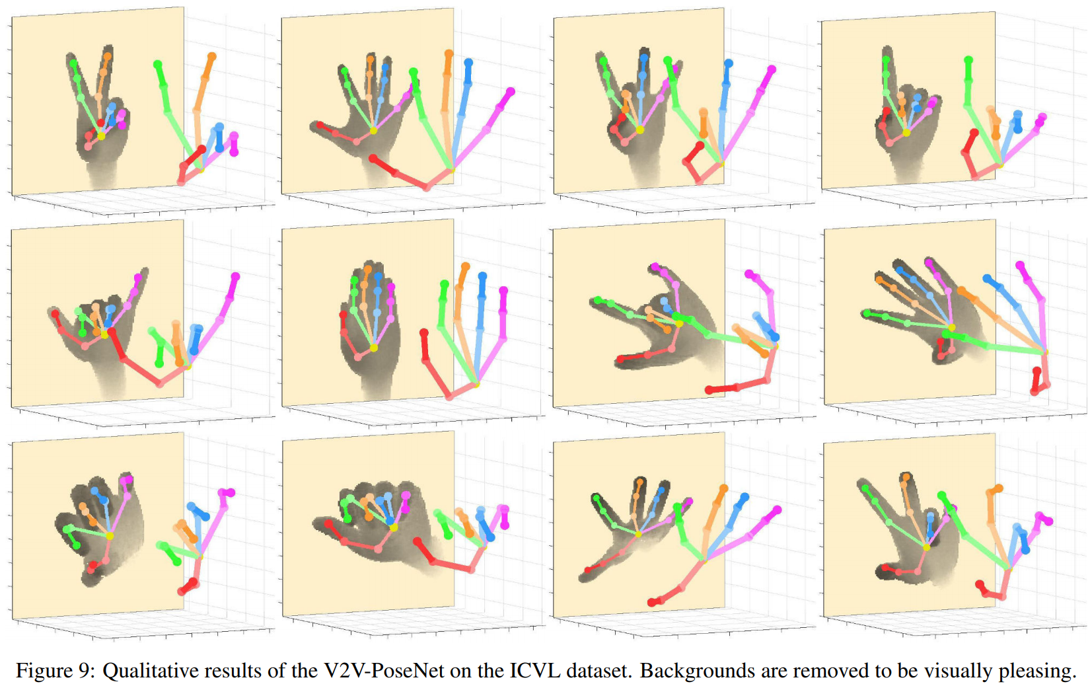
1. V2V-PoseNet Voxel-to-Voxel Prediction Network for Accurate 3D Hand and Human Pose Estimation from a Single Depth Map
Summary: Voxel-to-Voxel Prediction Network for Accurate 3D Hand and Human Pose Estimation from a Single Depth Map"(CVPR2018)
Team SNU CVLAB, (Gyeongsik Moon, Juyong Chang, and Kyoung Mu Lee of Computer Vision Lab, Seoul National University) are winners of HANDS2017 Challenge
https://github.com/mks0601/V2V-PoseNet_RELEASE

Slide 3
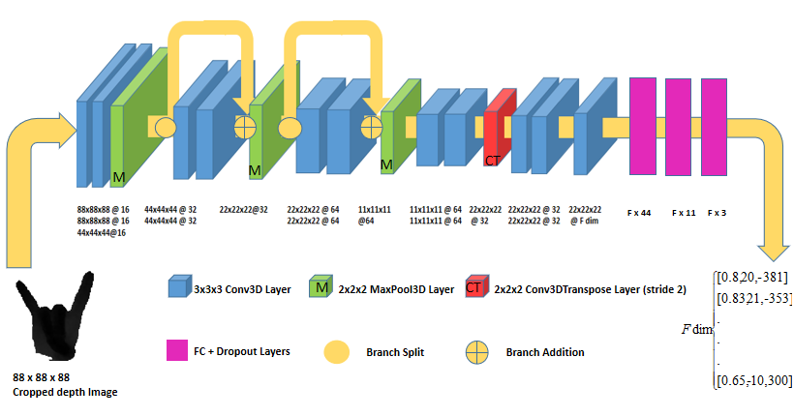
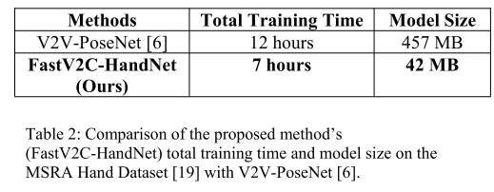
2. FastV2C-HandNet Fast Voxel to Coordinate Hand Pose Estimation with 3D Convolutional Neural Networks
Summary: Voxel-to-Voxel Prediction Network for Accurate 3D Hand and Human Pose Estimation from a Single Depth Map"(CVPR2018)
Paper: https://arxiv.org/pdf/1907.06327.pdf
GitHub: https://github.com/RonLek/FastV2C-HandNet

Slide 4
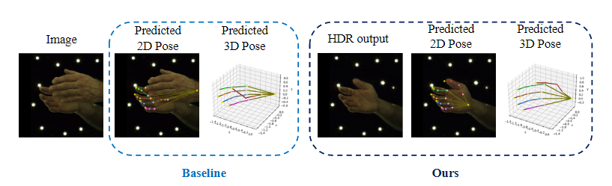
3. 3D Interacting Hand Pose Estimation by Hand De-occlusion and Removal(ECCV 2022)
Paper: https://arxiv.org/pdf/2207.11061.pdf
Summary: Official code and data for HDR
GitHub: https://github.com/MengHao666/HDR

Slide 5
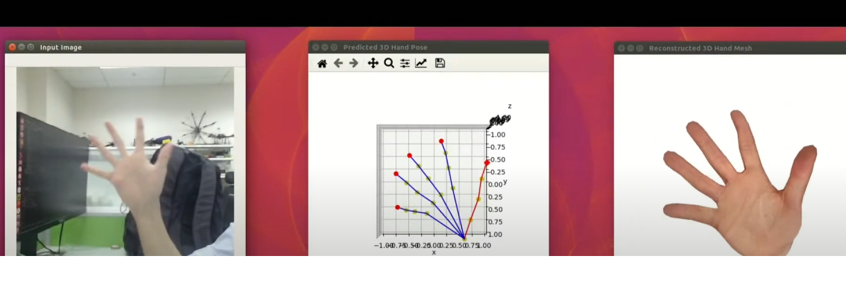
4. Minimal-Hand-pytorch(Unofficial)
PyTorch reimplementation of minimal-hand(CVPR2020)
Summary: Recognize gestures by extracting 3D coordinate values (coordinate value extraction may be useful)
Using “HybrIK: A Hybrid Analytical-Neural Inverse Kinematics Solution for 3D Human Pose and Shape Estimation”
https://github.com/MengHao666/Minimal-Hand-pytorch

Slide 6
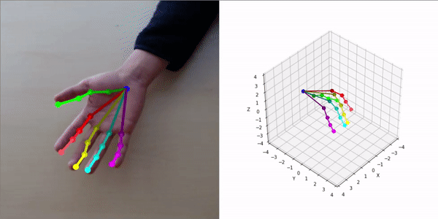
5. Real-Time-2D-and-3D-Hand-Pose-Estimation
Summary: Extract 2d and 3d coordinates from hands real-time (Unofficial: Minnesota CSCI 5561 course)
GitHub: https://github.com/enghock1/Real-Time-2D-and-3D-Hand-Pose-Estimation

